Slide 1

Efstathios Iosifidis
iosifidis@opensuse.org

Slide 2
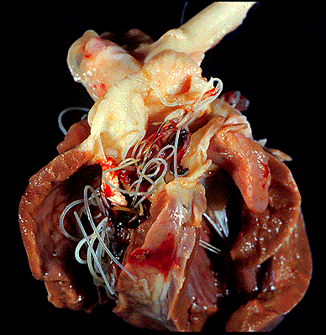
Heartworm disease
Dirofilaria immitis

Slide 3
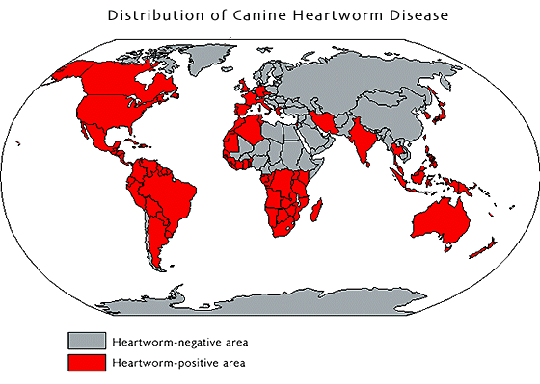

Slide 4
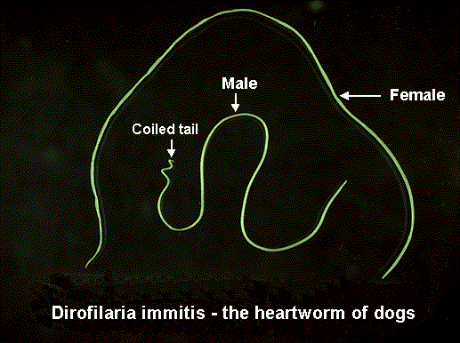
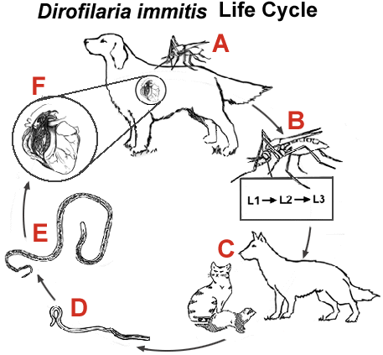

Prepatent: ~ 6.5months
Notes:
The interval between infection of an individual by a parasitic organism and the first ability to detect from that host a diagnostic stage of the organism.
Heartworms live in the heart and in the major arteries of the lungs. They can grow up to 10 to 14 inches in length and cause permanent heart and lung damage and even death.

Slide 5
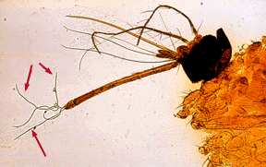
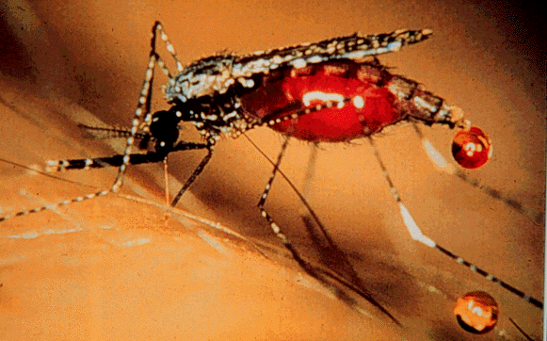

Slide 6
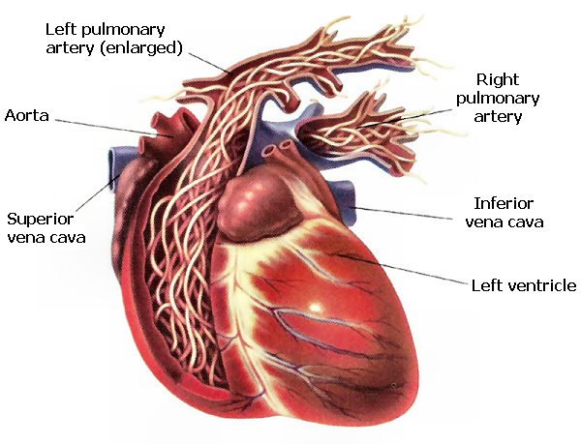
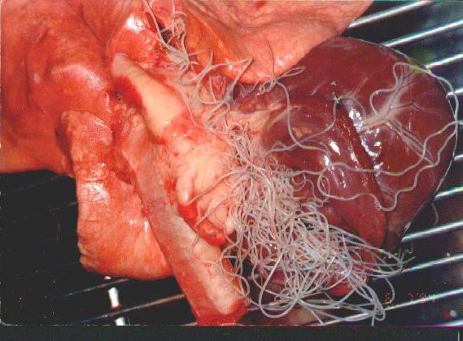
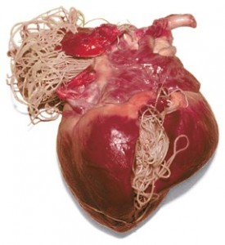

Slide 7
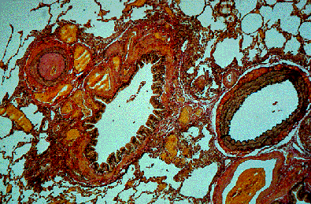
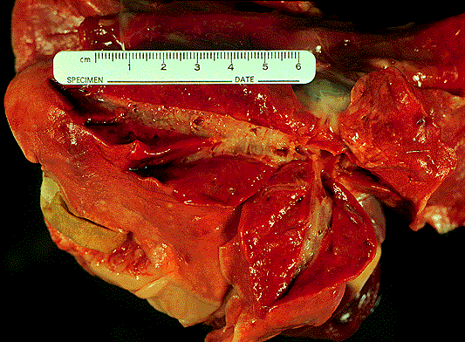


Slide 8
Symptoms
• 1st stage: none or smooth symptoms
• 2nd stage: weight loss, coughing, difficulty breathing, Sluggishness
• 3rd stage: same as stage 2, liquid in their belly

Slide 9
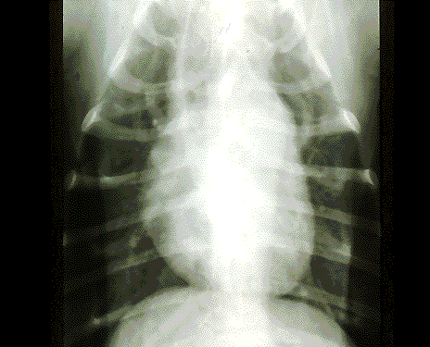
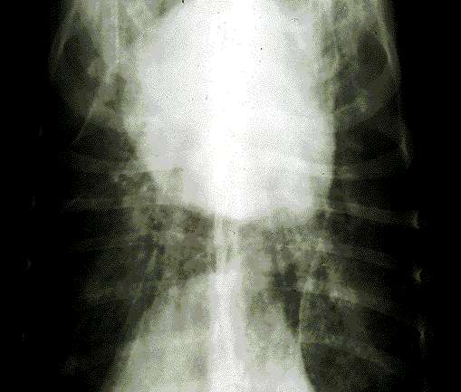

Slide 10
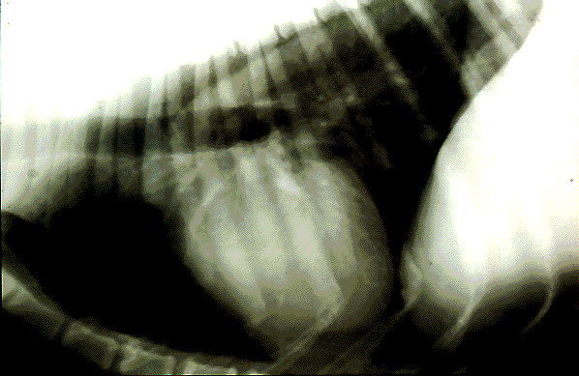
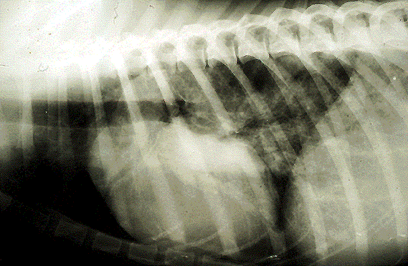

Slide 11

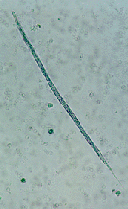
Diagnosis
1. Find microfilariae:
direct blood smear
modified Knott test
millipore filtration
2. Antigen testing
3. DNA testing
• X-rays
evaluate the amount of lung damage

Slide 12
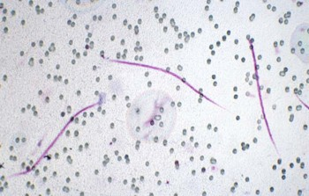
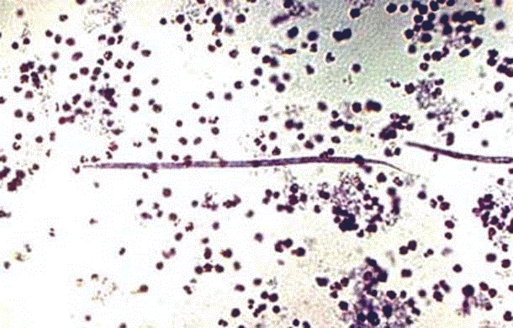
Microfilariae D. immitis (modified Knott test)

Slide 13
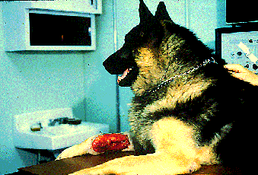
Treatment
Thiacetarsamide sodium
2,2 mg/kg /12h IV (!) for 2 days
Melarsomine dihydrochloride
2,5 mg/kg/24h IM, for 2 days
BE CAREFUL
♦ NO ACTIVITY FOR THE DOG
♦ POSSIBLE COMPLICATIONS
Ivermectin 50 μg/kg SC
Moxidectin 3μg/kg, per os
Milbemycin 0,5-2 mg/kg, per os
Check after 1 month
Notes:
the dog must be evaluated for heart, liver, and kidney function to evaluate the risks of treatment

Slide 14

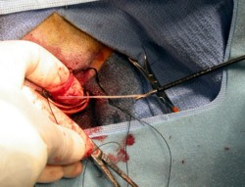
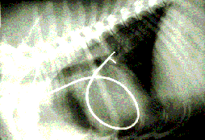
Surgerical removal
of adult parasites

Slide 15
Prevention
Ivermectin 6μg/kg
Milbemycin (Interceptor®) 0,5-1 mg/kg
Moxidectin (Cydectin®) 3 μg/kg
Selamectin (Stronghold®) 6 mg/kg
ONCE PER MONTH

Slide 16
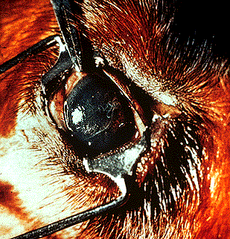
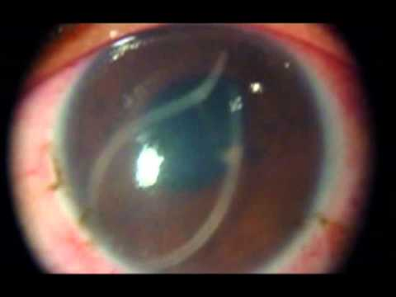
Lost worm

Slide 17
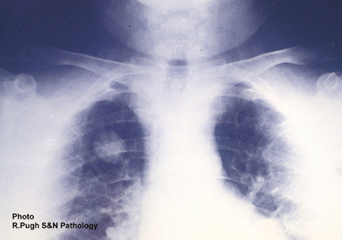
Public Health
- signs of respiratory disease (human is not physical host)
- lung granuloma, forms around the dead worm as it is being killed and absorbed (coin lesion)

Slide 18
Hypodermic heartworm
Dirofilaria repens
Dipetalonema reconditum
Usually without symptoms
Possible skin lesions

Slide 19
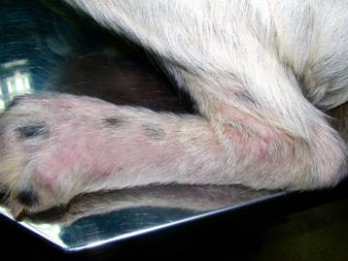
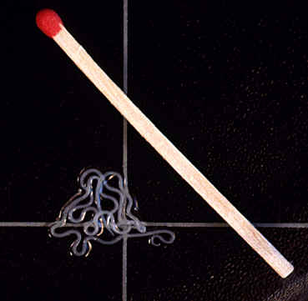

Hypodermic heartworm
Dirofilaria repens

Slide 20

Thank you

